Slide 1
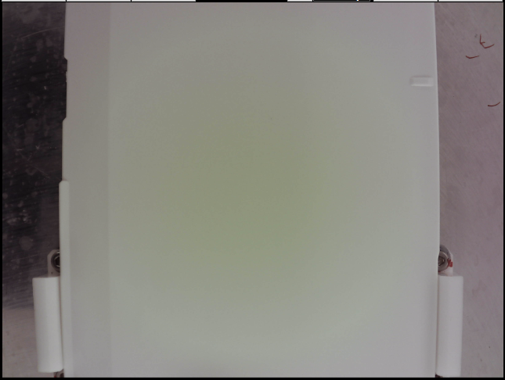
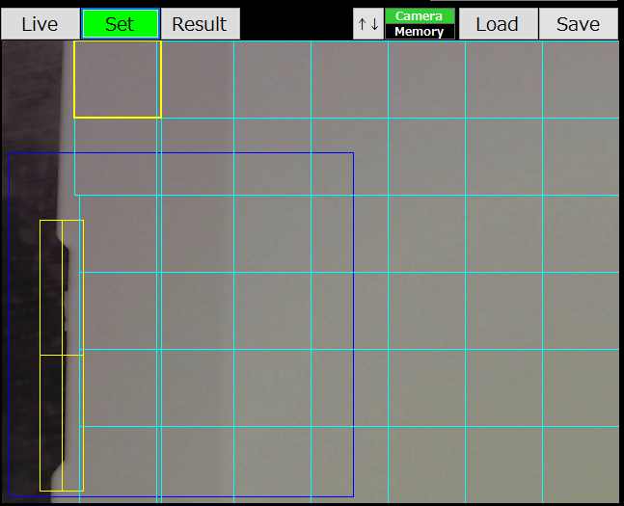
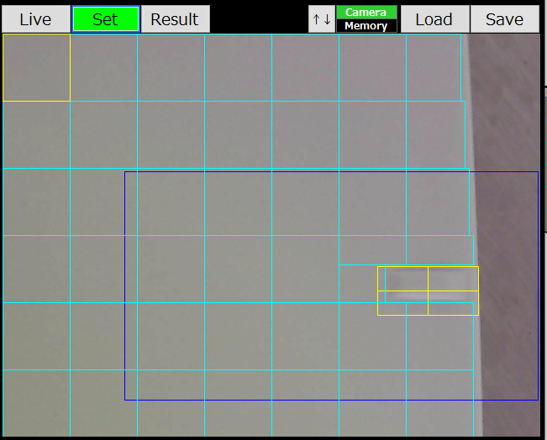
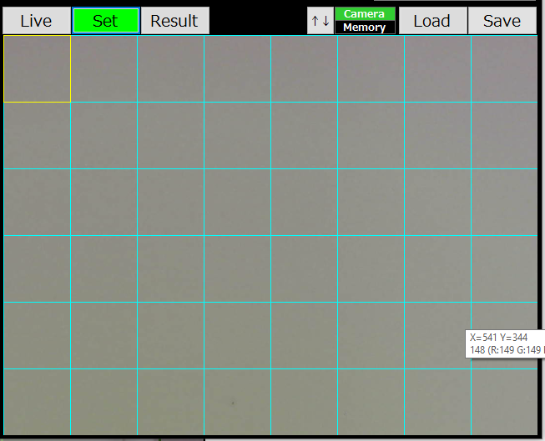
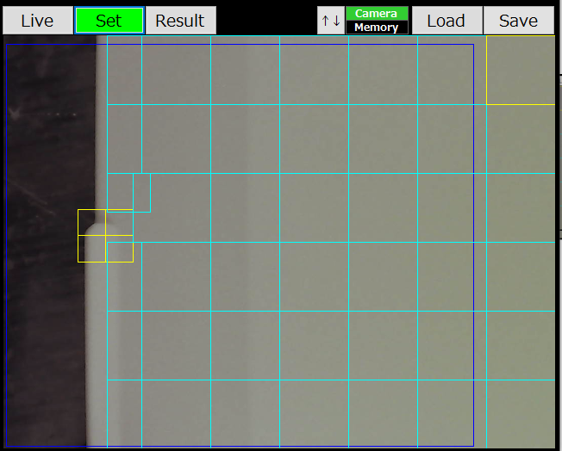
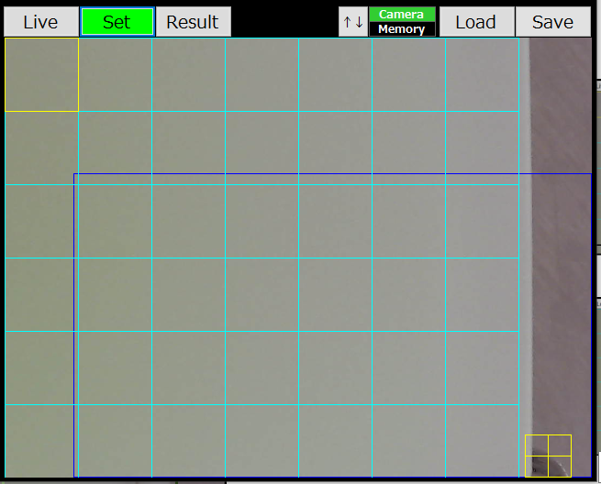
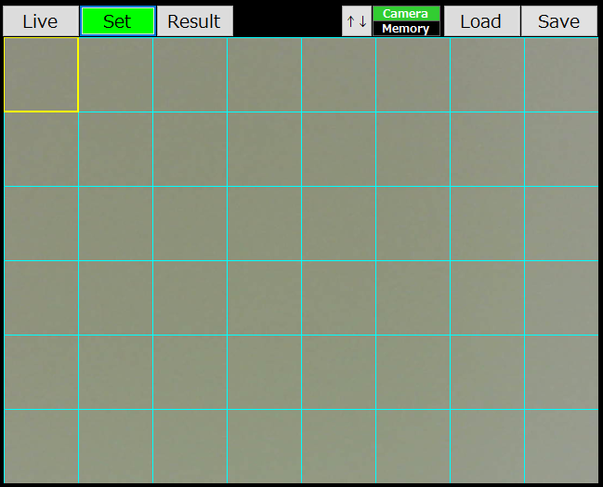
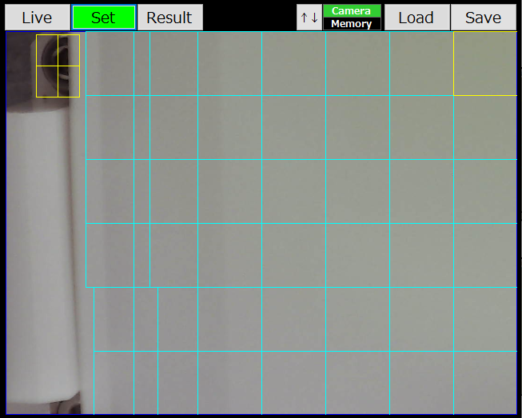
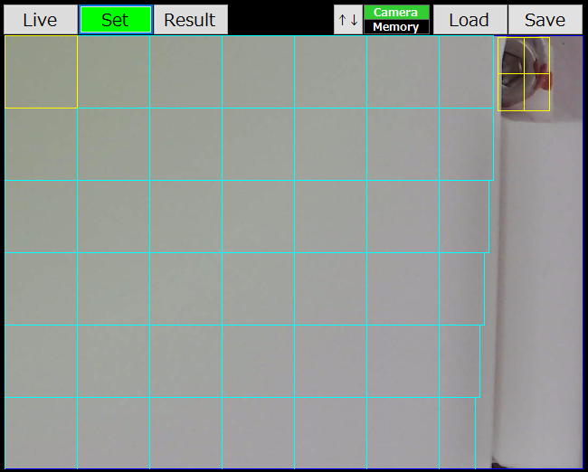
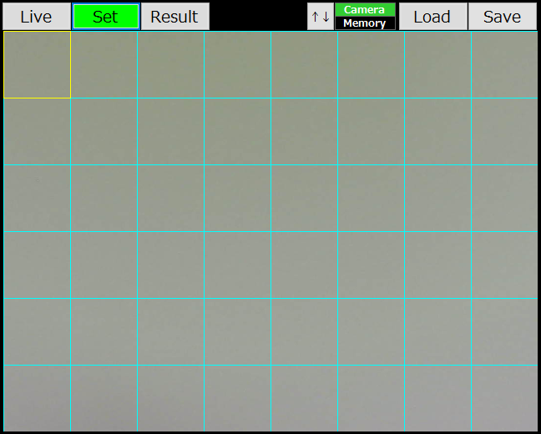
Flip testing
Concept
Original image
9 areas and zoom 3.0 scale
1
2
3
1
3
2
4
5
6
4
6
5
7
8
9
7
9
8

Slide 2
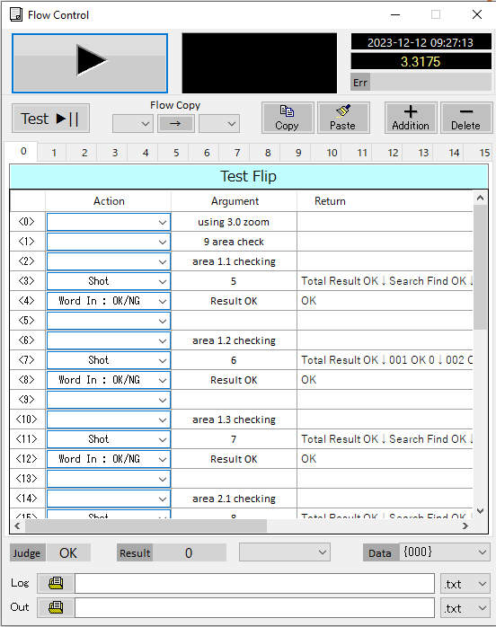
Flip testing
Concept
9 areas and zoom 3.0 scale
9 settings
Using flow control to run all settings

Slide 3

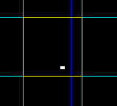
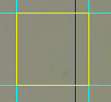
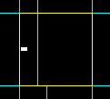
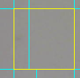
Flip testing
Actual debug
Check normal samples
No | Total time checking | OK | NG | Reason NG | Image
1 | 50 | 48 | 2 | Detect dust on part
2 | 50 | 45 | 5 | Detect dust on part
3 | 50 | 50 | 0
4 | 50 | 50 | 50
5 | 50 | 42 | 8 | Detect dust on part

Slide 4
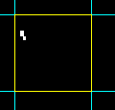

Flip testing
Actual debug
Check normal samples
No | Total time checking | OK | NG | Reason NG | Image
6 | 50 | 50 | 0
7 | 50 | 50 | 0
8 | 50 | 50 | 0
9 | 50 | 50 | 0
10 | 50 | 50 | 0
11 | 50 | 50 | 0
12 | 50 | 50 | 0
13 | 50 | 43 | 7 | Detect dust on part

Slide 5
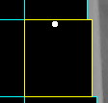
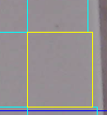


Flip testing
Actual debug
Check normal samples
No | Total time checking | OK | NG | Reason NG | Image
14 | 50 | 42 | 8 | Detect dust on part
15 | 50 | 50 | 0
16 | 50 | 50 | 0
17 | 50 | 50 | 0
18 | 50 | 50 | 0
19 | 50 | 50 | 0
20 | 50 | 50 | 0
21 | 50 | 50 | 0
22 | 50 | 46 | 4 | Detect dust on part

Slide 6






Flip testing
Actual debug
Check normal samples
No | Total time checking | OK | NG | Reason NG | Image
23 | 50 | 50 | 0
24 | 50 | 50 | 0
25 | 50 | 42 | 8
26 | 50 | 50 | 0
28 | 50 | 50 | 0
29 | 50 | 45 | 5
30 | 50 | 43 | 7 | Detect dust on part

Slide 7
Flip testing
Actual debug
Check NG samples
No | Total time checking | OK | NG | Reason NG | Image
1 | 50 | 50 | 0
2 | 50 | 50 | 0
3 | 50 | 50 | 0
4 | 50 | 50 | 0
5 | 50 | 50 | 0
6 | 50 | 50 | 0
7 | 50 | 50 | 0
8 | 50 | 50 | 0
9 | 50 | 50 | 0
10 | 50 | 50 | 0

Slide 8
Flip testing
Result debug
No | Item | Accuracy | Item affect to accuracy
1 | OK samples | 90% | dust on part
2 | NG samples | 100%

